Slide 1
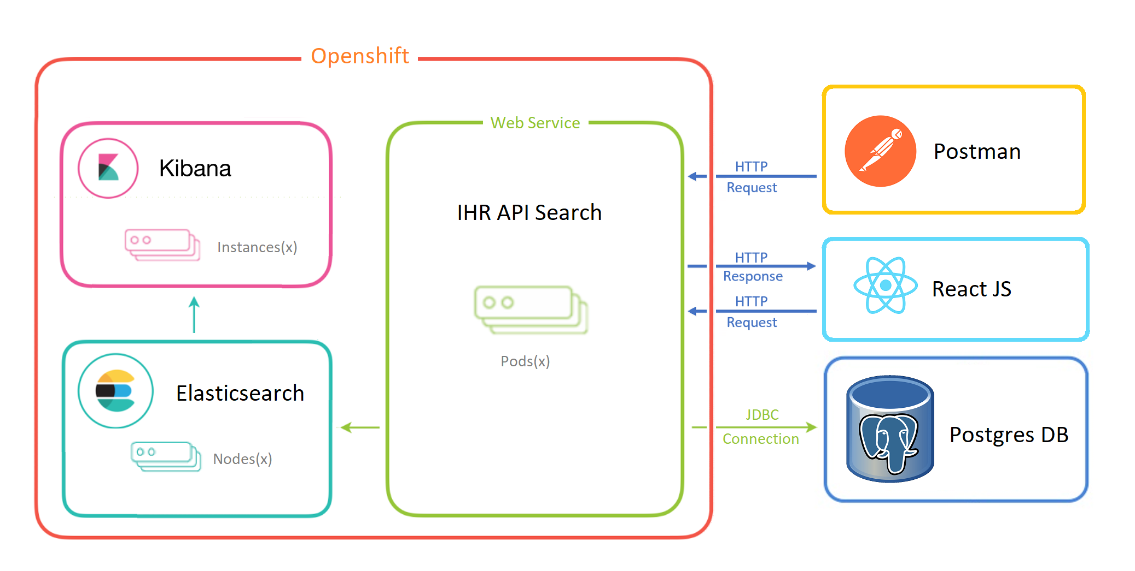
IHR API – Typeahead Service
_______________________________________________

Slide 2
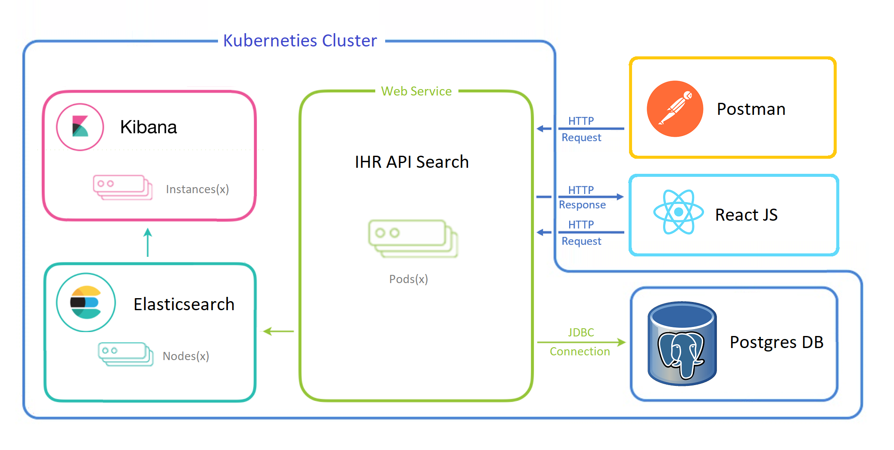
IHR API – Typeahead Service
_______________________________________________

Slide 3
IHR API – Typeahead Service
_______________________________________________
?

